Slide 1
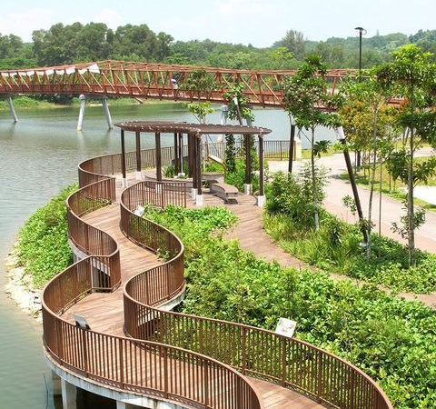
How
Park Connector Network
Planning Effectively
Support Daily Activities
for People in Singapore?
Judah Yosia. 1008352
Michael S. Susanto. 1008350

Slide 2
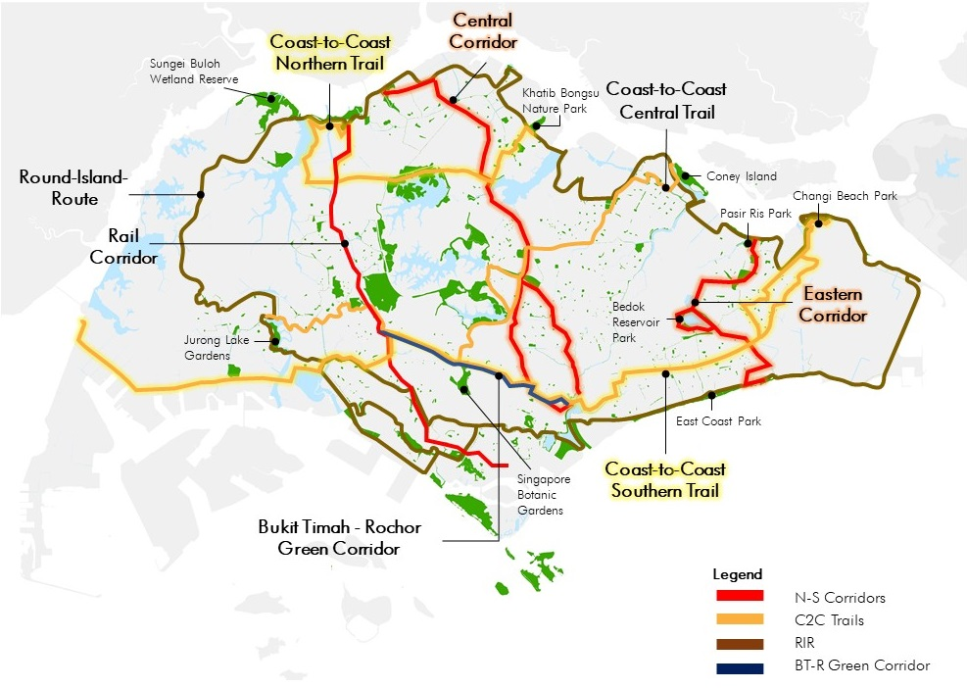
Singapore’s Park Connector Network
The Park Connector Network (PCN) was developed to create a matrix of green connectors linking Singapore's parks, gardens, and nature reserves. It aimed to increase residents' accessibility to nature and greenery while promoting environmental stewardship
The PCN has revolutionized commuting and recreation in Singapore, allowing residents to cycle or walk through green corridors. It promotes a healthier lifestyle, provides a refreshing commute to work, and contributes to Singapore's goal of becoming a car-light city (Lee, Zhan et al. 2020).
Source : NParks. (2024). Island-wide routes. NParks Park Connector Network. https://pcn.nparks.gov.sg/know-our-pcn/island-wide-routes/

Slide 3
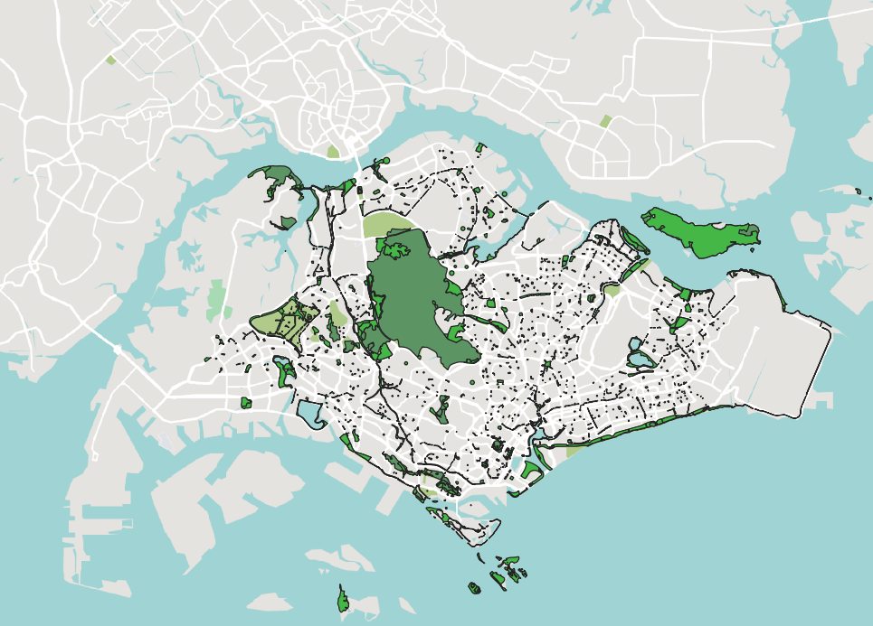
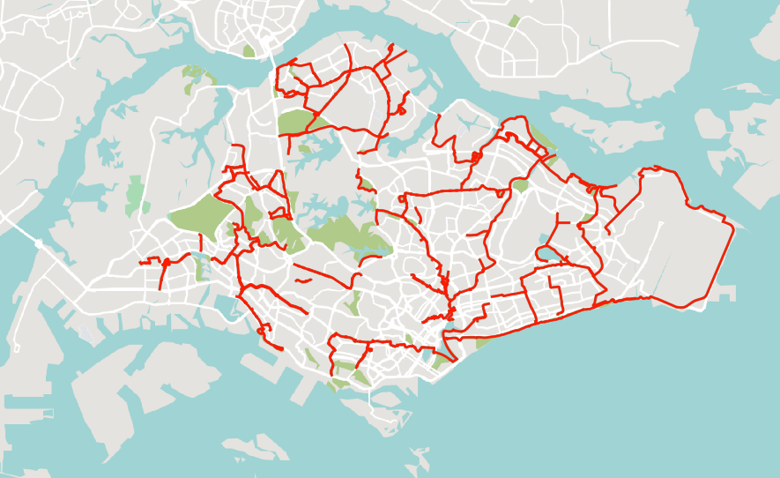
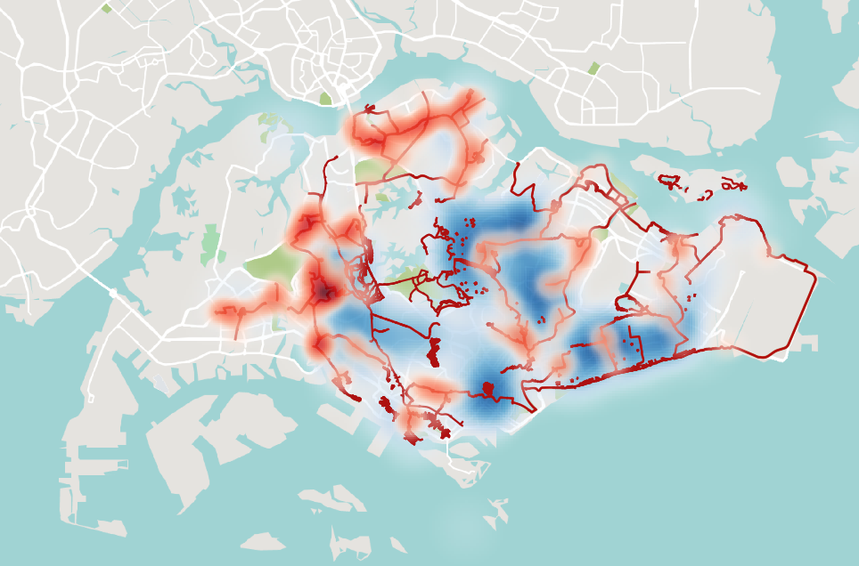
What
The Data will involve :
Singapore Maps
Park Connector Loop Datasets from Both Nparks and URA
Park Connector Masterplan 2019 from URA
Spatial Data of HDBs
Spatial Data of Offices and Amenities
Source : NParks (2023), URA (2024)

Slide 4
Park Connector is meant to enhance the vibrancy of the nature and the city within Singapore. The initial idea to connect nature helps to provide people for biodeiversity in their daily activities. However, understanding the park connector network is not that easy to understand, as some of area has not been connected to this initative. With Data Vizualisation, we hope to support people to understand the accessibility for them to use park connector network as part of their daily lives and also helps planning to be more integrated and try to spot which area is lack access or less accessible for people in Singapore.
Why
By visually representing data related to the network, such as the locations of existing connectors, planned expansions, and areas that require improvement, data visualization tools can provide a clear and comprehensive overview of the network's availability and connectivity.
Individuals can easily identify the nearest park connectors to their location, helping them incorporate these routes into their daily commutes or exercise routines. Moreover, data visualization allows users to assess the connectivity between different areas, helping them plan their routes more efficiently and effectively.
Data visualization also serves as a powerful tool for urban planners and decision-makers. By analyzing and visualizing data on park connector usage, footfall, and feedback from users, planners can identify which areas are less accessible or lack connectivity. This information enables them to prioritize infrastructure improvements or additions in these areas, ensuring that the Park Connector Network continues to expand and enhance accessibility for all residents.

Slide 5
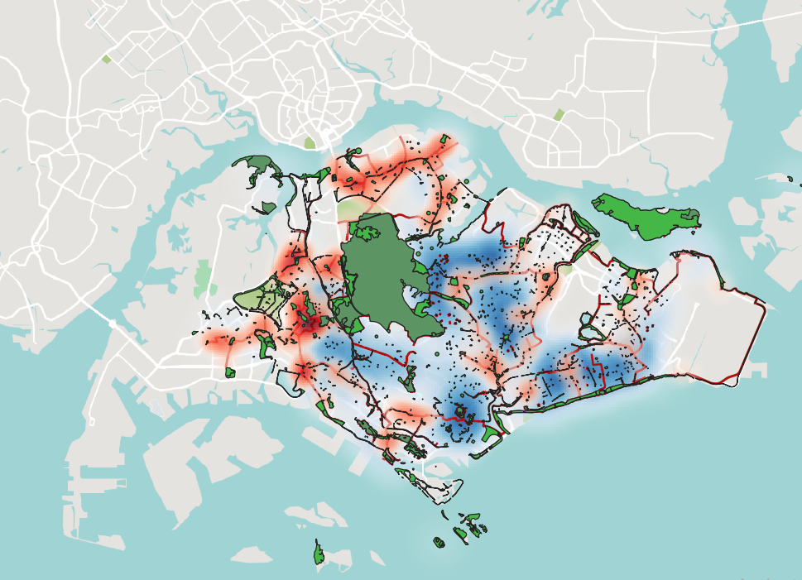
Cloropleth Maps
To represent the spatial distribution of HDB buildings and highlight areas with limited park connector access
Heat Maps
Possibility to depict the density of park connector usage and help identify popular areas.
Spatial Overlay
By overlaying commercial and amenities areas onto the park connector network, you can create a visual representation of the accessibility of these facilities from different parts of the network.
Network Diagram (TBC)
Network diagrams can visually represent the connectivity between MRT stations/HDBs/Commercial Areas and the park connector network.
Potential Outcome
Existing Park Connector Loop Maps
Indication of access to park connector networks
Spatial HDB Buildings to identify the connected areas and lack of accesses to support people’s daily activities
Spatial Commercial and/or Amenities Areas to indicate the potential accessibility from home to office/amenities (Ini kalo terlalu ambi, kita bisa focus ke HDB aja sih lol)
Identify the accessibility of MRT Station with the park connector networks.
Idiom
Source : One Street Maps (2024), NParks (2023), URA (2024)

